Slide 1



G.H. RAISONI COLLEGE OF ENGINEERING AND MANAGEMENT
Department of Information Technology
Project Presentation
PROJECT TITLE: “Stock Market Prediction Using Machine Learning”
GROUP NO :15
Guide: Ms.Vaishali Anaspure
Name of Student:
BITA04- Aditya Munjal
BITA10- Fazal Mehmood
BITA08- Atharva Chavan
BITA12- Ganesh Shinde

Slide 2
Contents
Problem statement
Abstract
Introduction
Objective
Need of project
Aim of project
Literature survey
Hardware and software requirements
System Architecture
UML diagrams
Technical Specifications
Project plan
Estimation
Result
Achievements
Conference paper
Conclusion
References

Slide 3
Problem Statement
1. Stocks are Unpredictable: Stock prices go up and down all the time, and this unpredictability has made them more popular.
2. Stock Market vs. Bank Loans: Companies like using the stock market to make money because it's faster and less paperwork compared to getting loans from banks.
3. Stock Market is Hard to Understand:Even though we can explain it briefly, fully understanding and predicting it is tricky and takes a lot of effort.
4. Many Factors Affect Stocks:Lots of things outside the market influence stock prices, which makes it tough to predict accurately. There's no one-size-fits-all prediction method.
5. Accuracy Challenge in Predictions:The main problem is figuring out the right guesses in a market that's always changing. This means combining data, making smart predictions, and considering different factors to reduce risks and make more money over time.

Slide 4
Abstract
Stock is an unpredictable curve. Prediction in the stock market is covered with complexity and instability. The main aim of the persuasion of the topic is to predict the stability in the future market stocks. Many researchers have performed their research on the movement of future market evolution. Stock consists of fluctuating data which makes data an integral source of efficiency. Impact on the same chances the efficiency of the prediction. In the recent trend of Stock Market Prediction Technologies machine learning has integrated itself into the picture for deployment and prediction of training sets and data models. Machine Learning employs different predictive models and algorithms to predict and automate things of requirement. The Paper focuses on the use of Regression and LSTM to predict stock values.

Slide 5
Introduction of Project
Stock Market in Simple Terms:
Stocks are like tiny pieces of companies that anyone can buy. People buy them, thinking they'll grow in value over time, sort of like a long-term savings plan. But here's the catch: the stock market is super unpredictable. It goes up and down all the time, and no one can fully figure out the pattern. Some experts try to predict it, but they can be expensive to hire.
Companies also use stocks to make money. Instead of taking big loans from banks with high interest rates, they sell stocks to collect funds. This helps them run their businesses smoothly and make more profits. For investors, it's a bit of a gamble. They put their savings into stocks and hope they'll make more money when the stock prices go up. If the prices go higher, they can sell their stocks for a profit. It's a bit like luck, and people even treat it as a side business. So, stocks are like pieces of companies you can buy, but they're also a bit of a gamble. high-interest

Slide 6
Objective
Predict the future stalk rates and the approximate growth factor of the company using 4 Machine Learning
• Use of Sentimental Analysis to study and give correct assumptions.
• Use of TF-IDF
• Improve stock price prediction

Slide 7
Motivation
To determine the data fluctuating or stable entities for the learning and implement for the real-world use of system.
decipher real time changes
characteristics of stock price, increasing interest in investments in stalks, and awareness about means of studies for stalks.
Analysis is given on the trend in given for period of time

Slide 8
Need of project
The Stock Market Prediction project aims to mitigate investment risks by predicting stock rates and exchange rates. It leverages data-driven insights, recognizing that knowledge is essential in the unpredictable stock market. By identifying patterns and dependencies in financial data, the project empowers users to make informed decisions, bridging resources, and enhancing their understanding of stock market dynamics. The ultimate goal is to provide a reliable tool for forecasting and ensuring more informed investments in this ever-changing financial landscape.

Slide 9
Aim
The main aim of the persuasion of the topic is to predict the stability in the future market stocks. Many researchers have performed their research on the movement of future market evolution. Stock consists of fluctuating data which makes data an integral source of efficiency. Impact on the same chances the efficiency of the prediction. In the recent trend of Stock Market Prediction Technologies machine learning has integrated itself in the picture for deployment and prediction of training sets and data models.

Slide 10
Existing System
Limitations of Previous Learning Systems:
Past learning systems were simplistic and limited.
Insufficiency in tackling complex computational tasks and efficiency concerns.
Vulnerabilities in Existing Models:
Inability to process rare or less common data, leading to significant data loss.
Challenges in forecasting and resource management due to incomplete data processing.
Importance of Observation and Prediction:
Observation crucial for resource management and accurate predictions.
Lack of observability in existing systems affects time estimation and market reliability.
Biases in Stock Market Predictions:
Bias in data sources impacts stock market predictions.
Emphasize the need for diverse and flexible data sources for more accurate predictions.
Challenges of Dynamic Stock Variation:
Stock variations daily create challenges in prediction accuracy.
Initial instances used for prediction might lead to increased margin of error over time.

Slide 11
Proposed System
Stock Behavior Characteristics:
Unpredictable and fluctuating nature of stock.
Combination of impressive trends and hesitant shifts.
Objective: Achieving Predictability:
Goal is to approach predictability and aim for the closest possible estimation.
Acknowledgment that while exact accuracy might be challenging, near estimation is feasible.
Consideration of Stock Constraints:
Various constraints impact stock pricing and rate fluctuations.
Emphasize the need to account for these constraints before drawing conclusions.
System Flow:
Input sourced from the dataset.
Extraction of features and subsequent classification.
Utilization of supervised classification techniques.
Machine Learning Implementation:
Implementation of diverse machine learning algorithms on the classified dataset.
Development of training datasets for machine learning model training.
Testing and Visualization:
Derivation and execution of test cases for visualization and plotting purposes.
Utilization of test cases to demonstrate patterns and outcomes.

Slide 12
Literature Survey
Sr. No. | Paper Name & Author | Publication Year | Conclusion
1. | Analyzing Stock Market Trend Prediction using Machine & Deep Learning Models 978-1-7281-9437- 0/20/$31.00 ©2020 IEEE.DOI: 10.1109/CITISIA50690.2020.93 71852 | 2020 | This paper aims to provide a comprehensive review of the exiting research which related to the application of Machine Learning and Deep Learning models in the financial market forecasting domain
2. | Stock Market Prediction using Ensemble of Deep Neural Networks. 978-1-7281-6946- 0/20/$31.00 ©2020IEEE | 2020 | this paper leverages deep neural networks with ensemble learning to address this problem. We propose ensemble of Convolutional Neural Network (CNN), Long Short Term Memory (LSTM), and 1DConvNet with LSTM (Conv1DLSTM) to predict the stock market price, named EnsembleDNNs.
3. | Predicting Stock Market trends using machine learning and deep learning.DOI:10.1109/ACCE SS.2020.2012966, IEEE | 2020 | This study compares nine machine learning models (Decision Tree, Random Forest, Adaptive Boosting (AdaBoost), eXtreme Gradient Boosting (XGBoost), Support Vector Classifier (SVC), Naïve Bayes, K-Nearest Neighbors (KNN), Logistic Regression and Artificial Neural Network (ANN)) and two powerful deep learning methods (Recurrent Neural Network (RNN) and Long short-term memory (LSTM).
Reddy, V. K. S. (2018). Stock market prediction using machine learning. International Research Journal of Engineering and Technology (IRJET), 5(10), 1033-1035.

Slide 13
Literature Survey
Sr. No. | Paper Name & Author | Publication Year | Conclusion
4. | Prediction of TCS Stock Prices Using Deep Learning Models. 978-1-6654- 0521- 8/20/$31.00 ©2021 IEEE | DOI: 10.1109/ICACCS51430.2021.94 4185 | 2021 | This paper, Statistical method SARIMA is used to predict stock prices. To improve the outcome of forecasting five Deep Learning models namely Single-Layer LSTM, Three-Layer LSTM, Bidirectional LSTM, CNN LSTM and Convolutional LSTM are used. In Single-Layer LSTM and Three-Layer LSTM models LSTM layers are used to give better output.
5. | Predicting Stock Market Price: A Logical Strategy | 2021 | This research work uses the frequently used algorithms Long Short Term Memory, Extreme Gradient Boosting (XGBoost), Linear Regression, Moving Average, and Last Value model on more than twelve months of historical stock data to build up a prediction model for forecasting stock price.
6. | Analysis of Investor Sentiment and Stock Market Volatility Trend Based on Big Data Strategy | 2019 | This paper collects the data of web news emotion index, web search volume, social network emotion index, social network heat index, and establishes corresponding analysis index.

Slide 14
Literature Survey
Sr. No. | Paper Name & Author | Publication Year | Conclusion
7. | Sentiment Analysis for Stock Price Prediction | 2020 | This project, we investigate the impact of sentiment expressed through StockTwits on stock price prediction. StockTwits is a relatively new microblogging website, which is becoming increasingly popular for users to share their discussions and sentiments about stocks and financial markets.
8. | Analysing the Trend of Stock Marketand Evaluate the performance of Market Prediction using Machine Learning Approach | 2021 | Detailed information regarding the existence of stock market variations is identified by collecting the information from previous historical data for making the choice of predictions strategy by considering the data with the stock analyst's experts of the stock market analysis system.

Slide 15
Hardware and software requirements Specifications
Hardware:
Processor: Intel i3 or above
RAM: Minimum 2GB or more.
Hard Disk: Minimum 2 GB of space
Input Device: Keyboard
Output Device: Screens of Monitor or a Laptop.)
Software:
Operating System: Windows and Linux
IDE Visual Studio, Jupiter notebook, anaconda navigator
Data Set CSV File
Visualization library Math plot lib, pandas
. Server Webserver with HTTP Process, Radis server Anaconda Navigator

Slide 16
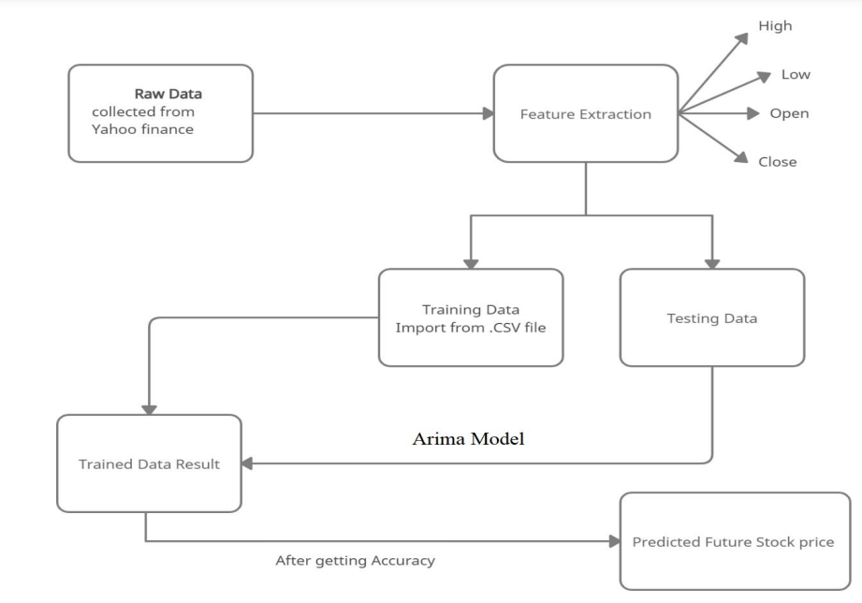
System Architecture

Slide 17
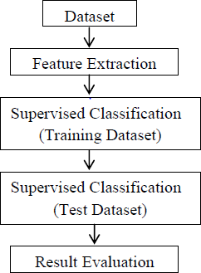
Architecture
Block Diagram

Slide 18
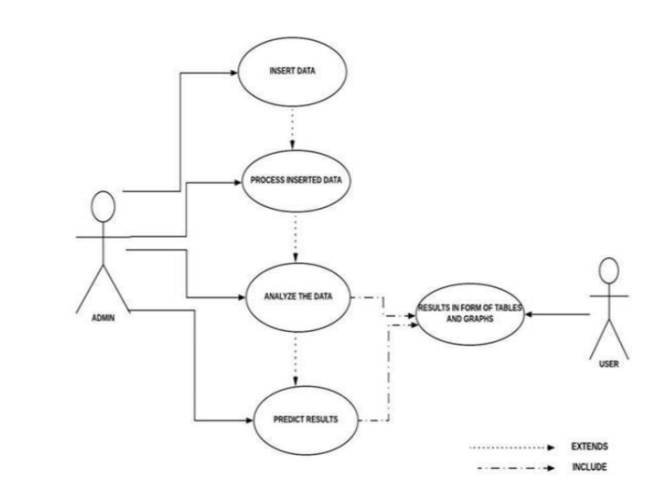
UML Diagram
UML is a notation that resulted from the Unification of Object Modeling Technique and Object-Oriented Software Technology. UML has been designed for broad range of application. Hence, it provides constructs for a broad range of systems and activities.

Slide 19
Technical Specification
Matplotlib:
Matplotlib is a versatile and comprehensive library for creating static, animated, and interactive visualizations in Python. It provides a wide range of tools for creating various types of plots and charts, such as line plots, bar charts, scatter plots, histograms, and more.
Pandas:
Pandas is a data manipulation and analysis library for Python. It provides data structures like Series and Data Frame that make it easy to work with structured data, such as CSV files, Excel spreadsheets, SQL databases, and more.
CSV
A CSV (Comma-Separated Values) file is a widely used plain text file format for storing and exchanging tabular data. CSV files are often used in data analysis, data storage, and data interchange because of their simplicity and ease of use.
REDIS
Redis is an open-source, in-memory data structure store that is often used as a caching mechanism, message broker, and data store. It's known for its speed and versatility and is commonly used in various applications, including web development, real-time analytics, and more.

Slide 20
Project Plan
Modules:
User Sign Up and Login Page
Backend and ML Model Building
Machine Learning Models

Slide 21
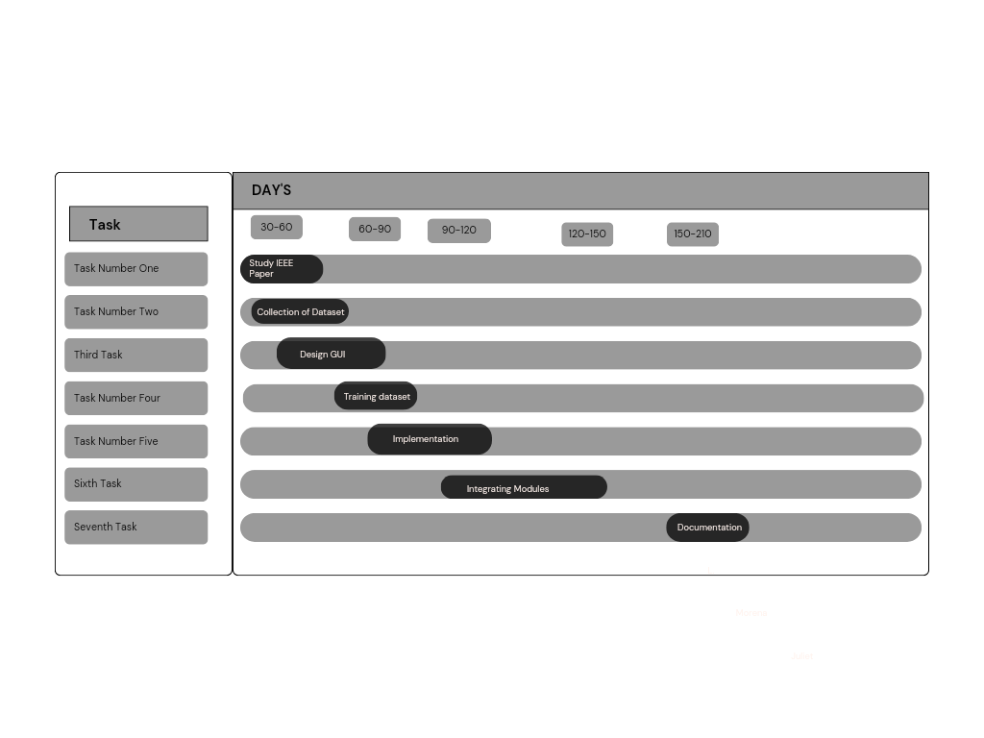
Timeline Chart

Slide 22
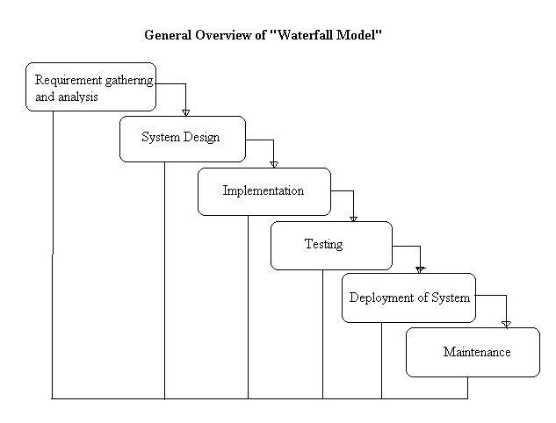
Estimation

Slide 23
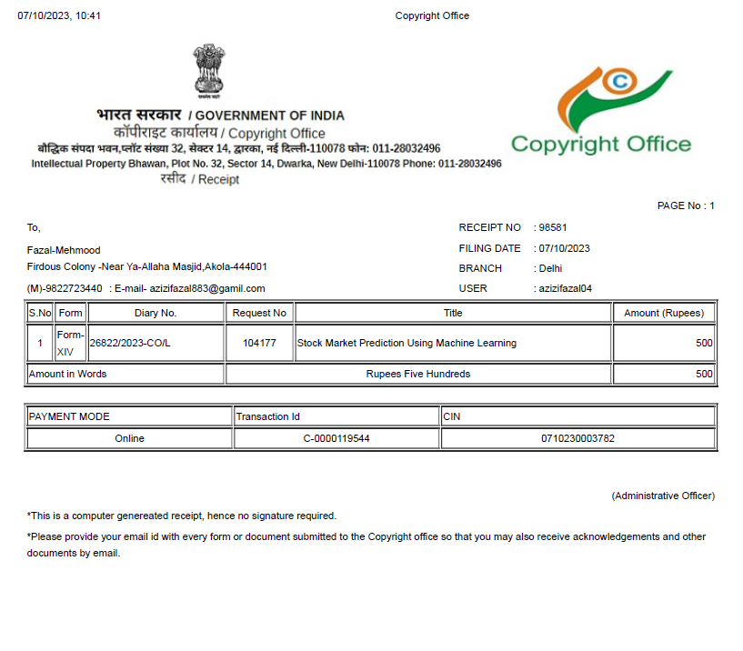
Achievements

Slide 24
Project Modules/Implementation Strategy
Module 1: User Authentication and Management
Submodule1.1: User Sign Up Page using HTML,CSS & Javascript
Create a User Sign Up Page:
Develop a web page using HTML,CSS and Javascript for user registration.
Include input fields for first name,last name, email, password, and confirm password.
Implement form validation to ensure proper input.
2. Handle User Registration:
On form submission, validate the input data and perform necessary checks (e.g., unique email).
If the input data is valid, send a request to the backend server to create a new user account.
3 Display Success/Failure Messages:
Show a success message upon successful user registration.
Display appropriate error messages if any validation or server-side errors occur.

Slide 25
Project Modules/Implementation Strategy
Submodule 1.2: User Login Detail Page using HTML,CSS & Javascript
Create a User Login Page:
Develop a using HTML,CSS & Javascript.
Include input fields for email/username separate web page for user login and password.
Handle User Login:
Validate the login credentials and check against the backend server for authentication.
Upon successful login, store the user's authentication token or session information.
Redirect to User Dashboard:
After successful login, redirect the user to their dashboard or the main application page.

Slide 26
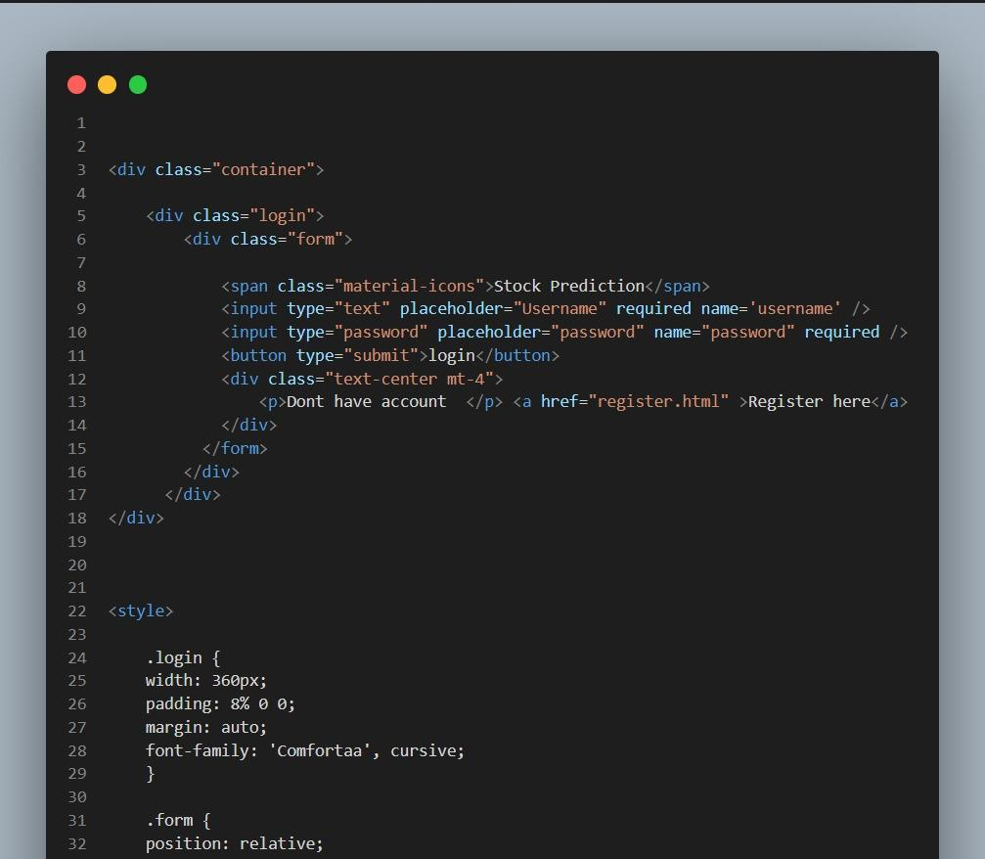
Coding

Slide 27
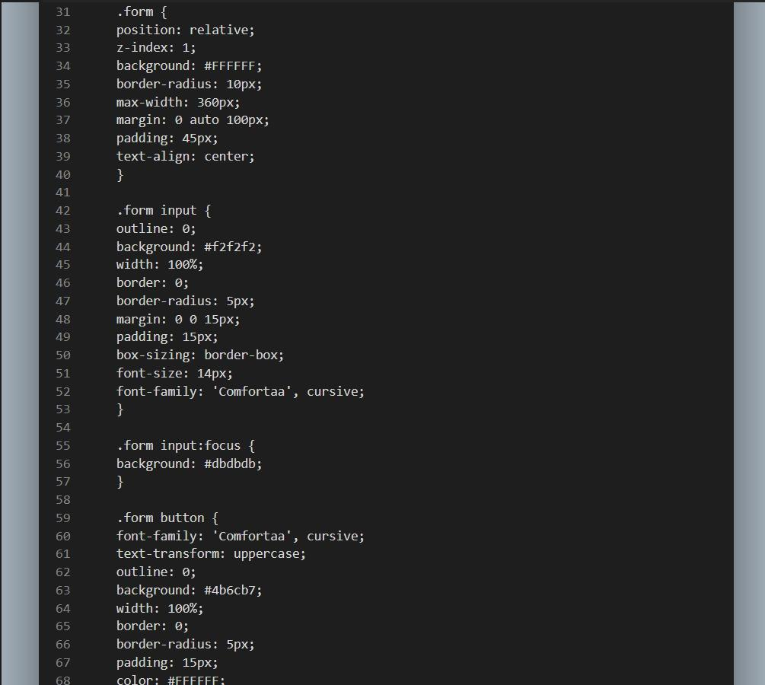
Coding

Slide 28
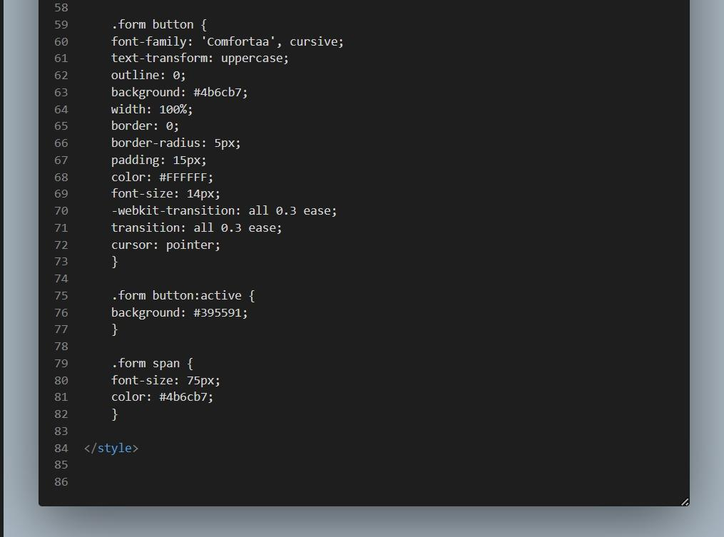
Coding

Slide 29
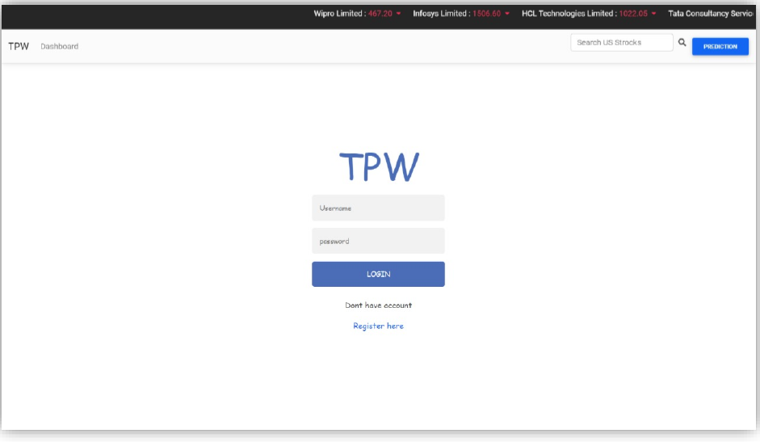
Result

Slide 30
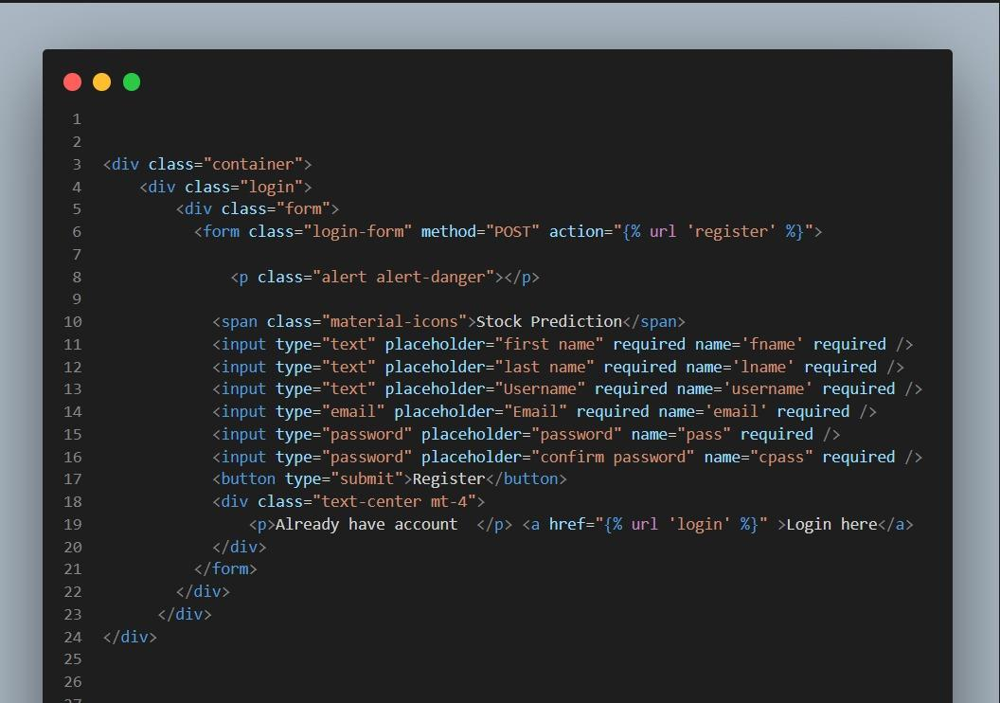
Coding

Slide 31
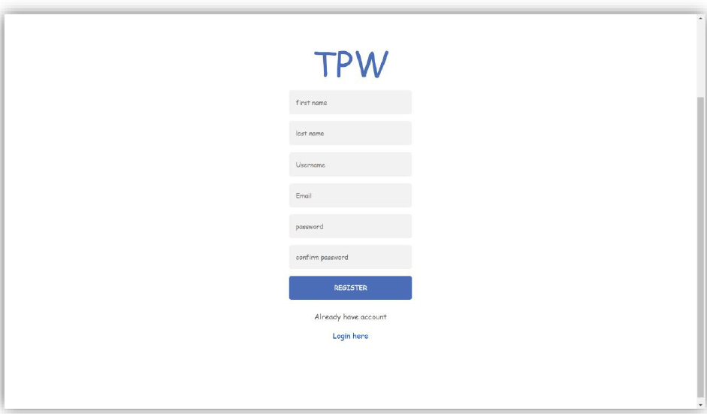
Result

Slide 32
Project Modules/Implementation Strategy
Module 2 : Backend Connectivity with Django
Submodule 2.1 : Django
1. Setup Django with Redis:
Install Redis on your server or local machine.
Create a new Django project or use an existing one
Connect to Redis from Python::
Using Python connect to Redis using the redis-py library. Install it using pip.

Slide 33
Project Modules/Implementation Strategy
These APIs likely provide various data related to the capital market, including price and volume data, equity lists, index data, and more. You would need to refer to the documentation of the nselib library for detailed information on how to use these APIs and what data they provide.
1. capital_market.price_volume_and_deliverable_position_data
2. capital_market.price_volume_data
3. capital_market.deliverable_position_data
4. capital_market.bulk_deal_data
5. capital_market.block_deals_data
6. capital_market.short_selling_data
7. capital_market.bhav_copy_with_delivery
8. capital_market.bhav_copy_equities
9. capital_market.equity_list
10. capital_market.fno_equity_list
11. capital_market.nifty50_equity_list
12. capital_market.india_vix_data
13. capital_market.index_data
14. capital_market.market_watch_all_indices
15. capital_market.fii_dii_trading_activity

Slide 34
Project Modules/Implementation Strategy
Submodule 2.2: Dashboard For Stock Prediction:
Design an interactive dashboard for users to make stock predictions.
Display real-time stock market data and relevant statistics.
Implement user-friendly data visualization tools (e.g., charts, graphs).
Integrate a machine learning model for stock price predictions
Allow users to input stock symbols or select from a list.
Submodule 2.3 Machine Learning Model Integration:
Train a machine learning model (e.g., LSTM, Random Forest) using historical stock data.
Integrate the trained model into the dashboard for making predictions.
Provide users with the ability to customize prediction parameters (e.g., time horizon)

Slide 35
Project Modules/Implementation Strategy
Submodule 2.4: Prediction Results:
Display predicted stock prices and trends in a visually appealing manner.
Include confidence scores or prediction intervals to indicate model uncertainty.
Enable users to compare predictions with actual stock prices.
Submodule 2.5: Future Enhancements:
Discuss potential future enhancements, such as mobile app development, additional prediction features, or integration with financial news sources..

Slide 36
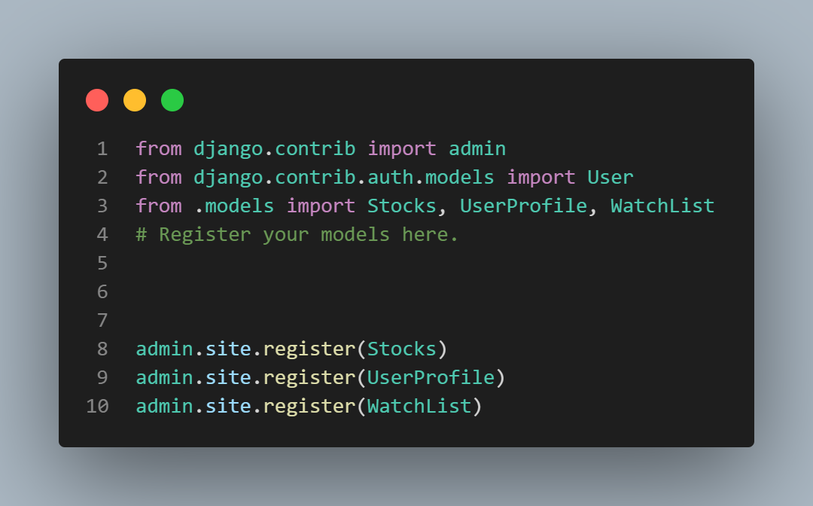
Coding

Slide 37
Coding

Slide 38
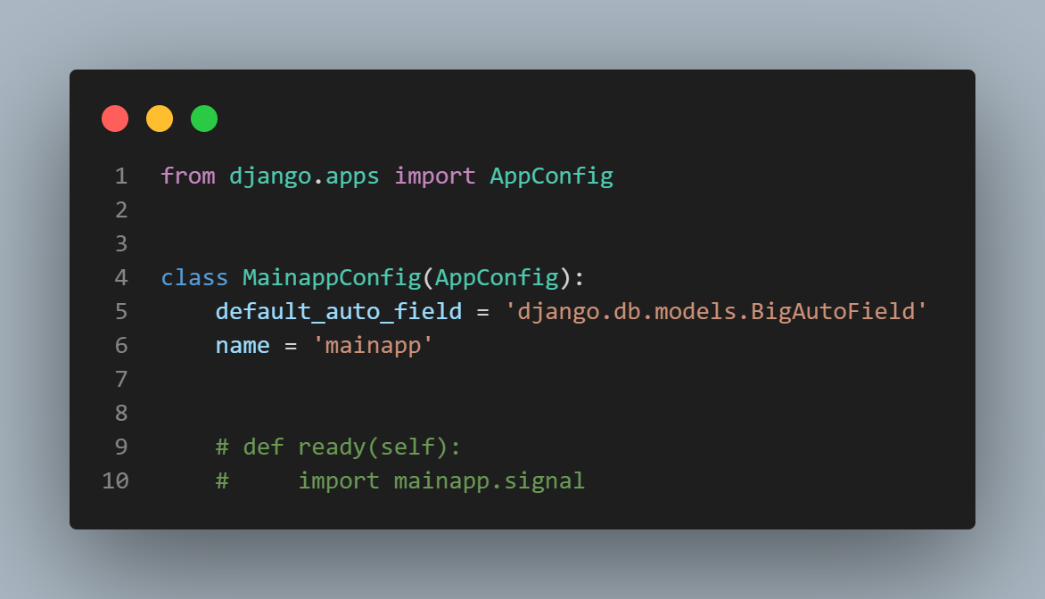
Coding

Slide 39
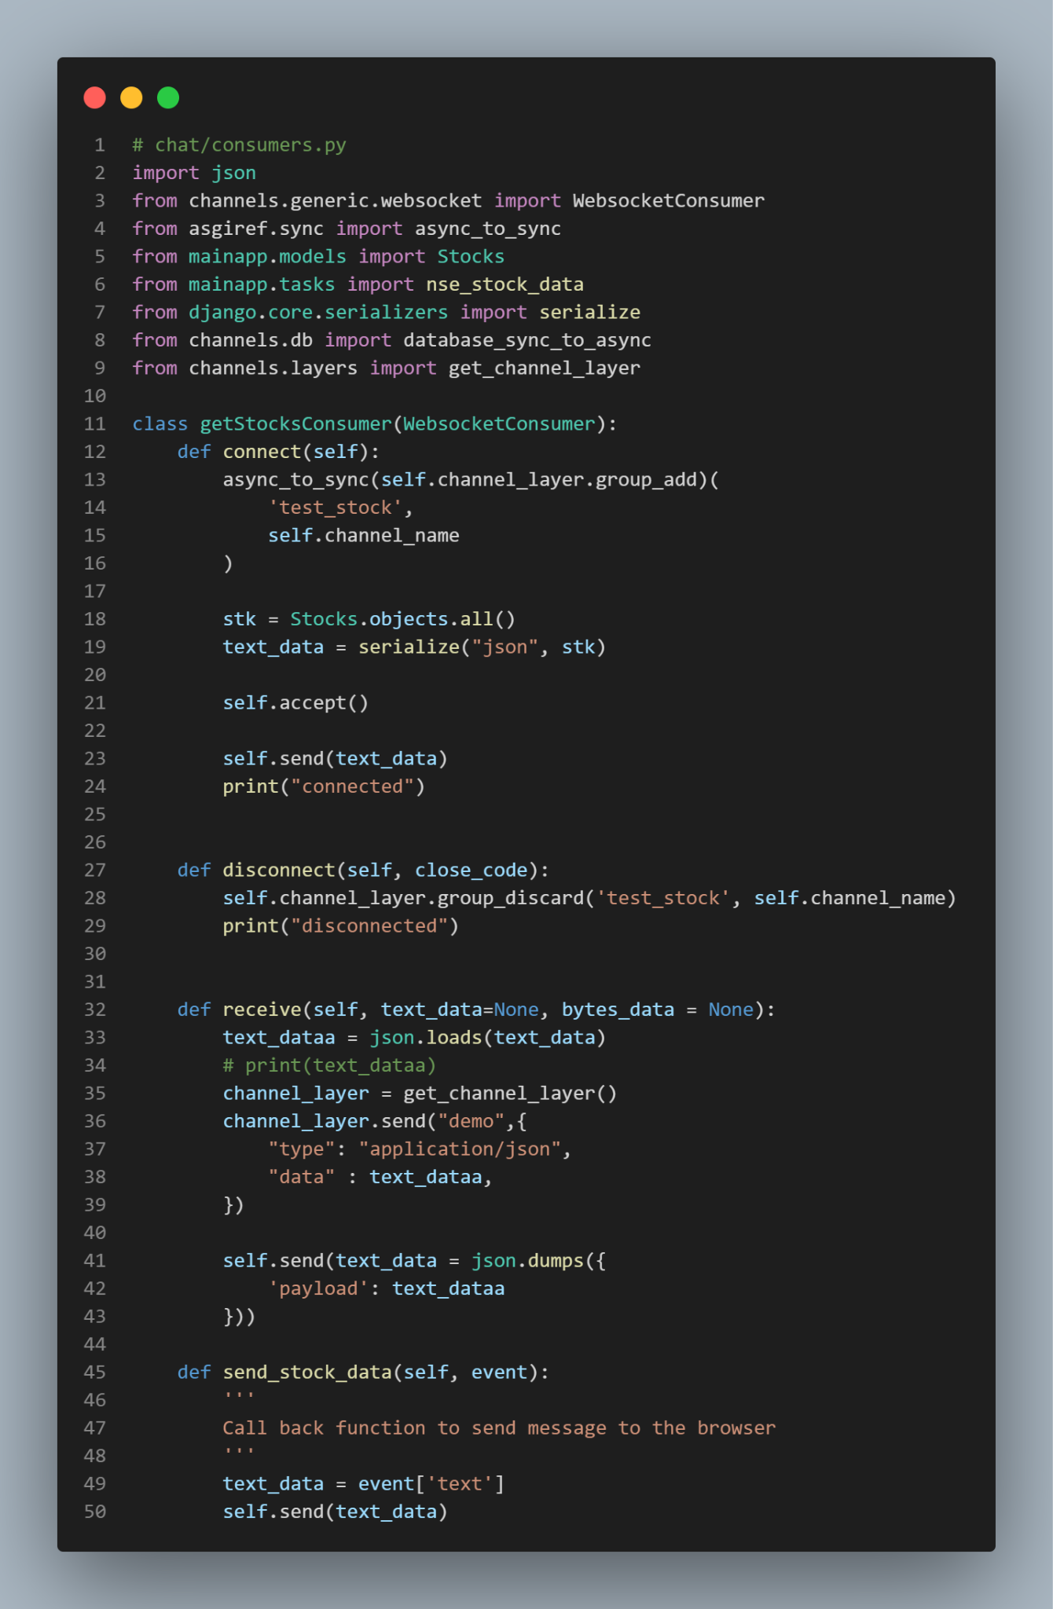
Coding

Slide 40
Project Modules/Implementation Strategy
Module 3:Machine Learning Models
ARIMA(AutoRegressive Integrated Moving Average)
ARIMA Model Overview:
ARIMA is a widely used time series forecasting model that combines AR (AutoRegressive), I (Integrated), and MA (Moving Average) components.
Model Parameters (p, d, q):
ARIMA is defined by three parameters: p, d, and q.
p: Lag order for autoregressive terms.
d: Degree of differencing to achieve stationarity.
q: Lag order for moving average terms.
Stationarity:
ARIMA requires data to be stationary, achieved through differencing.
Model Fitting and Validation:
Fit the model using historical data.
Forecasting:
Use the trained ARIMA model to predict future values.
Limitations:
ARIMA may struggle with complex data patterns and non-linearity.

Slide 41
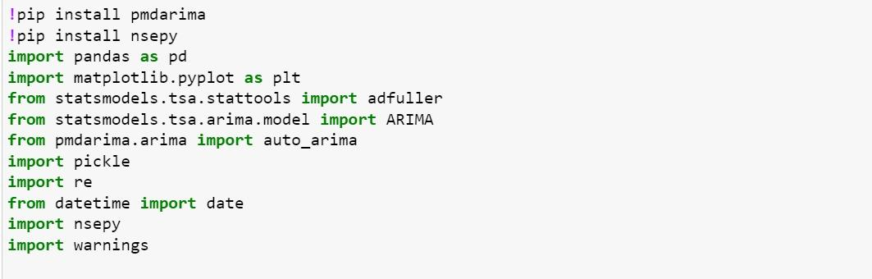
Coding

Slide 42
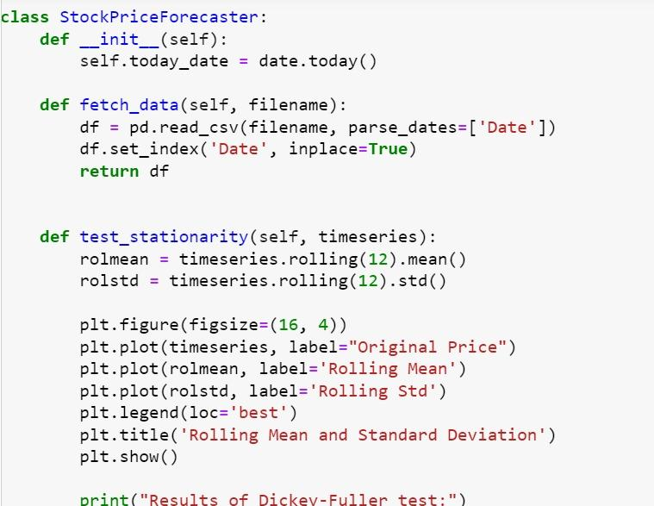
Coding

Slide 43
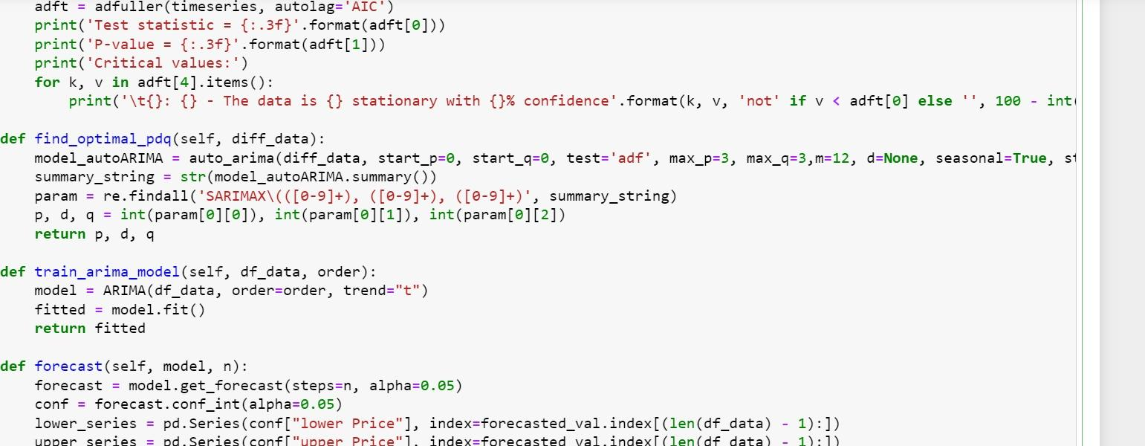
Coding

Slide 44
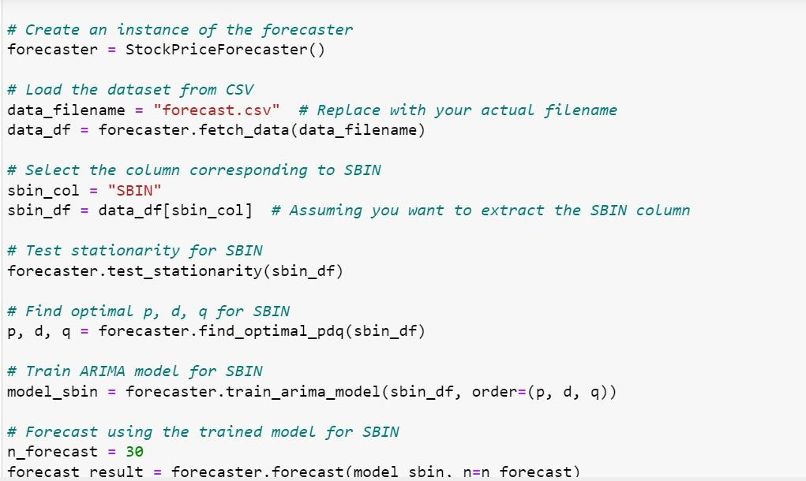
Coding

Slide 45
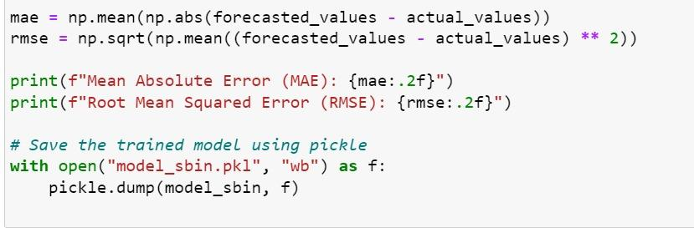
Coding

Slide 46
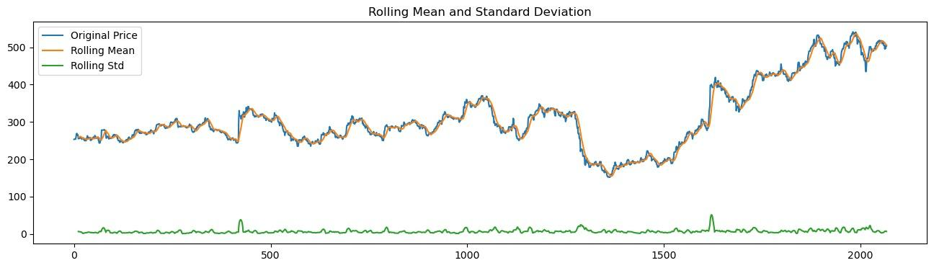
Result
SBI Graph:

Slide 47
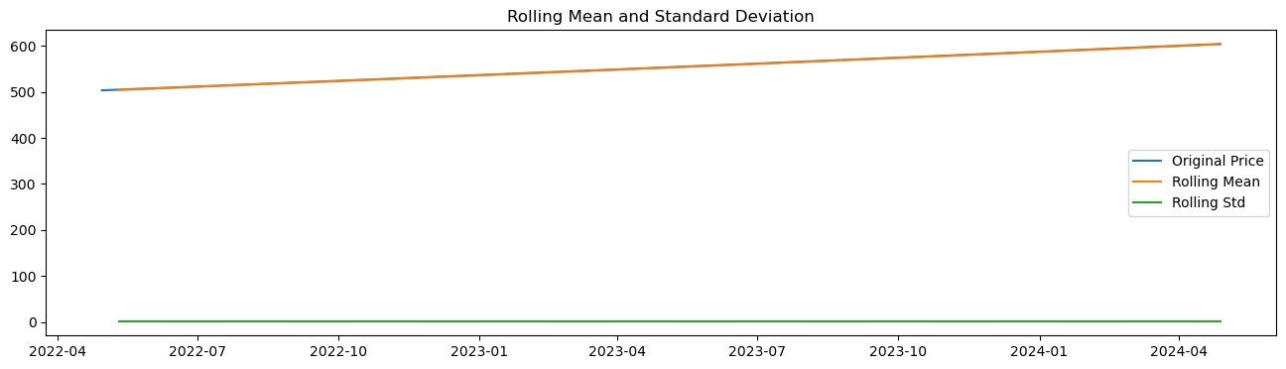
Result
SBI Graph:

Slide 48
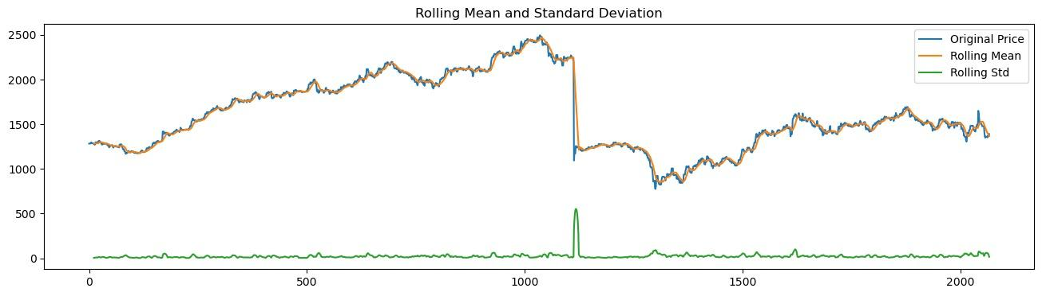
Result
HDFC Graph

Slide 49
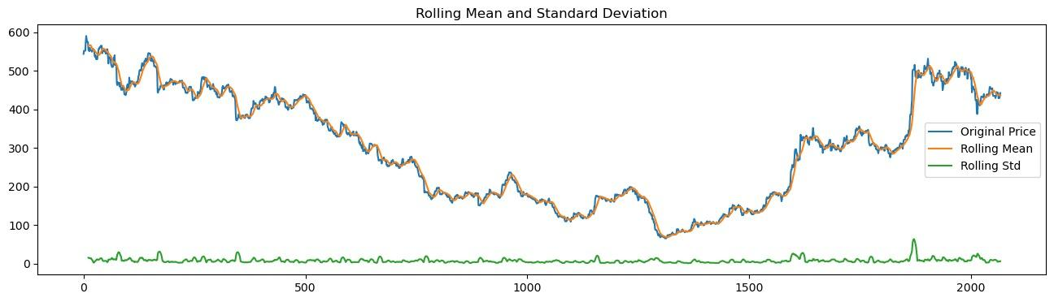
Result
TATA Motors Graph

Slide 50
Project Modules/Implementation Strategy
2) LSTM(Long Short Term Memory)
LSTM Model Overview:
LSTM is a type of recurrent neural network (RNN) designed for handling sequential data.
Sequence Modeling:
LSTM excels at modeling sequences, making it suitable for time series data like stock prices.
Memory Cells:
LSTM uses memory cells to capture long-term dependencies in data.
Gates:
LSTM has three types of gates (input, forget, output) that control information flow within cells.
Vanishing Gradient Problem:
LSTM mitigates the vanishing gradient problem, making it effective for learning from long sequences

Slide 51
Project Modules/Implementation Strategy
Stock Market Prediction:
Apply ARIMA to predict stock prices or trends based on historical data.
Tuning:
Fine-tune the model by experimenting with parameter values for better accuracy.
Conclusion:
ARIMA is a valuable tool for time series forecasting, including stock market prediction.

Slide 52
Project Modules/Implementation Strategy
Model Training:
Train LSTM models using historical stock data.
Use techniques like cross-validation to assess performance.
Integration with Stock Market Prediction:
Explain how LSTM is applied to predict stock market trends.
Highlight its suitability for capturing intricate stock price patterns.
Conclusion:
LSTM is a powerful tool for time series forecasting, particularly in stock market prediction,
due to its ability to model complex dependencies.

Slide 53
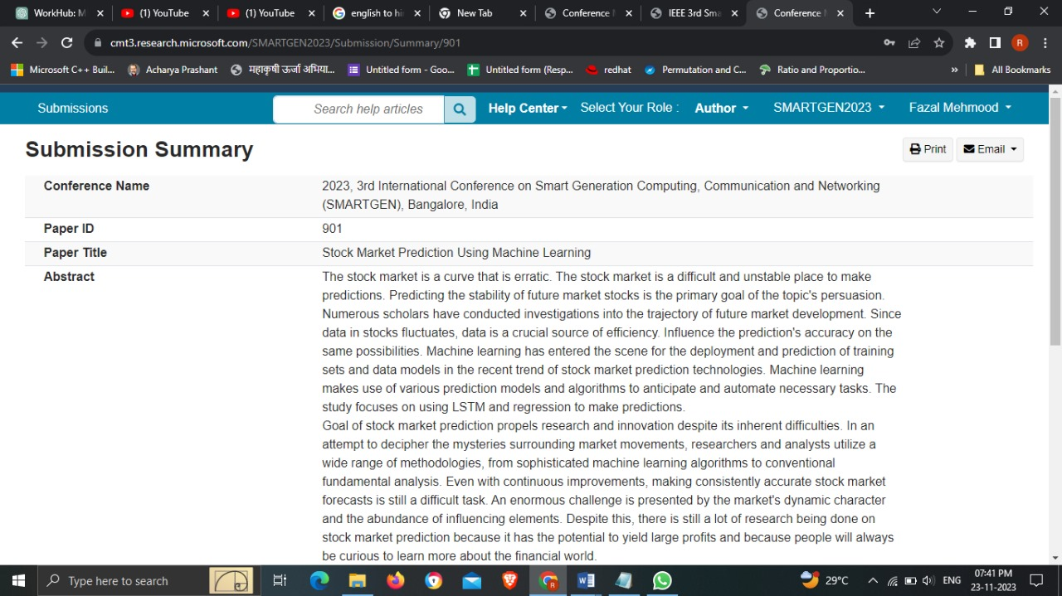
Screenshot of Article Submission to IEEE Conference

Slide 54
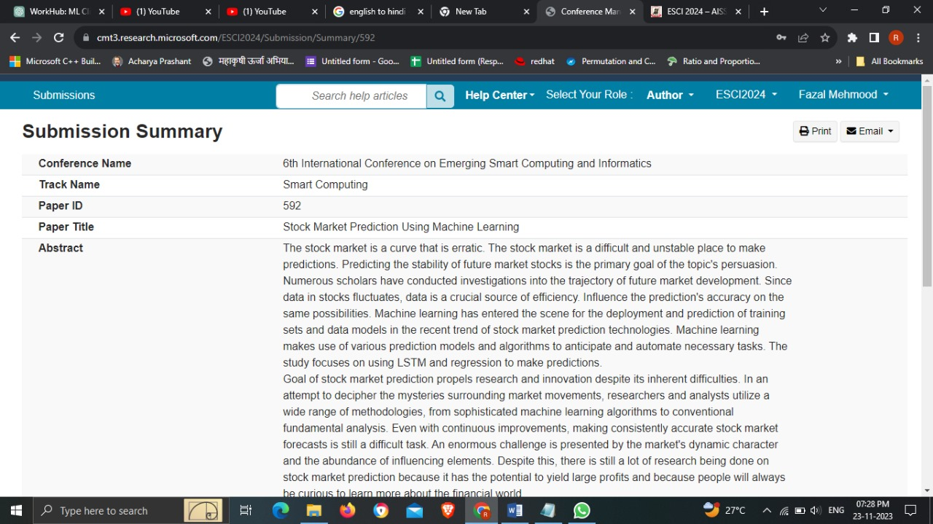
Screenshot of Article Submission to IEEE Conference

Slide 55
Conclusion
To conclude stock is an unpredictable mechanism which follows the segments of chain and the dependencies of the same are unpredictable. It is defined to be a curve which keeps on changing and turning the price from low to high and vice-versa.
As the integration of the same is higher with other dependencies so leaving one dependency compromises the level of accuracy. Accuracy is not the term used over in stock as the actual prediction is not possible for any fiscal days it keeps on changing and turning the tables day and night. Having higher component assets and the dependencies makes it more feasible and flexible in nature causing it even harder to predict. The approx. value is taken into consideration and the hit or profit or the gain rate is calculated for the same.
In the project various high level machine learning algorithms are implemented and integrated and the output is generated from the same making a user visible with the outputs in the form of graph which makes it easier for them to see and interpret what’s the scenario and they can decide on the same to invest and get the
benefit out of it,
The proposed software takes the raw set of data from the dataset or the .csv file and process it. The cleaning and cleansing of data are done and then further processed to gain the effective outcomes. After the computational mean the output is displayed in the screen in the form of graph.

Slide 56
References
[1] D. P. Gandhmal and K. Kumar, "Systematic analysis and review of stock market prediction
Techniques," Computer Science Review, vol. 34, 2019, doi: 10.1016/j.cosrev.2019.08.001.
[2] Patel, J., Shah, S., Thakkar, P., & Kotecha, K. (2015). Predicting stock and stock price index
ovemet using Trend Deterministic Data Preparation and machine learning techniques. Expert
Systems with Applications, 42(1), 259-268.
[3]E.Cambria, D. Olsher, and D. Rajagopal, ³Senticnet 3: a common and common-sense knowledge
base for cognition-driven sentiment analysis, ́ AAAI, pp. 1515±1521, 2014.
[4] M. Ballings, D. V. D. Poel, N. Hespeels, and R. Gryp, “Evaluating multiple classifiers for stock
price direction prediction,” Expert Systems with Applications, vol. 42, no. 20, pp. 7046–7056 2015.
[5] L. Nassar, I. E. Okwuchi, M. Saad, F. Karray and K. Ponnambalam, "Deep Learning Based
Approach for Fresh Produce Market Price Prediction," 2020 International Joint Conference on Neural Networks (IJCNN), Glasgow, United Kingdom, 2020, pp. 1-7, doi: 10.1109/IJCNN48605.2020.9207537.

Slide 57
References
[6] V. Unadkat, P. Sayani, P. Kanani and P. Doshi, "Deep Learning for Financial Prediction," 2018
International Conference on Circuits and Systems in Digital Enterprise Technology (ICCSDET), Kottayam, India, 2018, pp. 1-6, doi:10.1109/ICCSDET.2018.8821178.
[7] Convolutional LSTM, LSTM, Fully Connected doc- X. Shi, Z. Chen, H. Wang, D. Yeung, W.
Wong, and W. Woo, “Convolutional LSTM network: A machine learning approach for precipitation nowcasting,” CoRR, vol. abs/1506.04214,2015.
[8] https://ieeexplore.ieee.org/
[9] https://finance.yahoo.com/
[10] www.analyticsvidhya.com/blog/2017/09/common-machine-learning

Slide 58
Thank you !

